Slide 1
Sound and Hearing

Slide 2
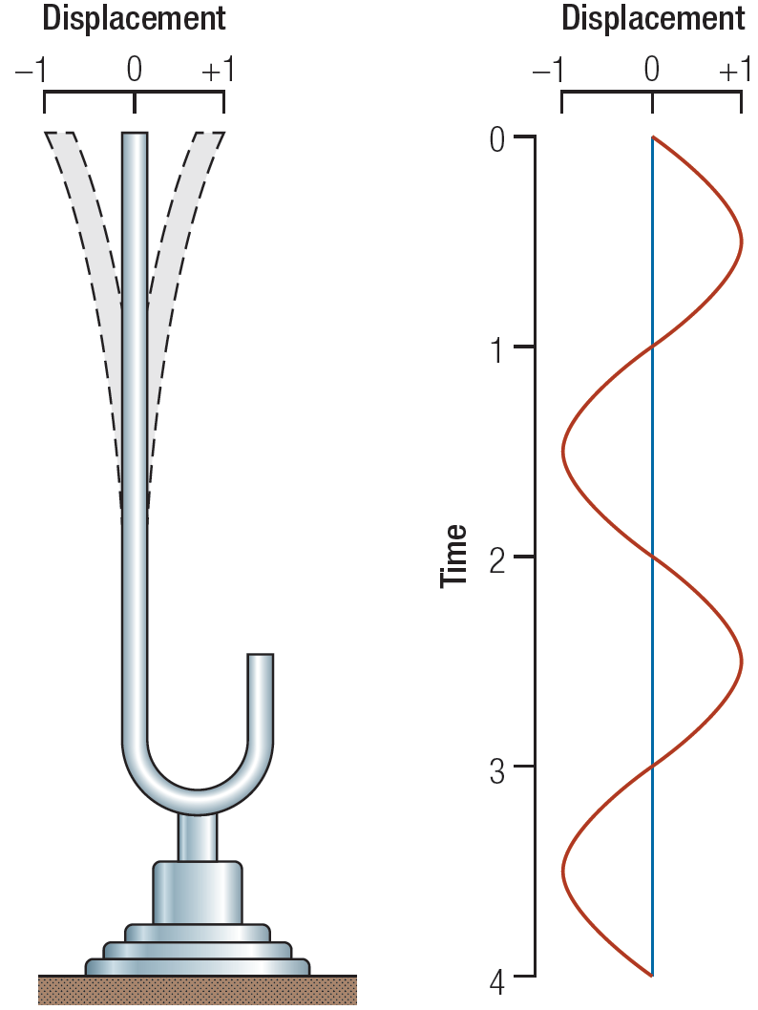
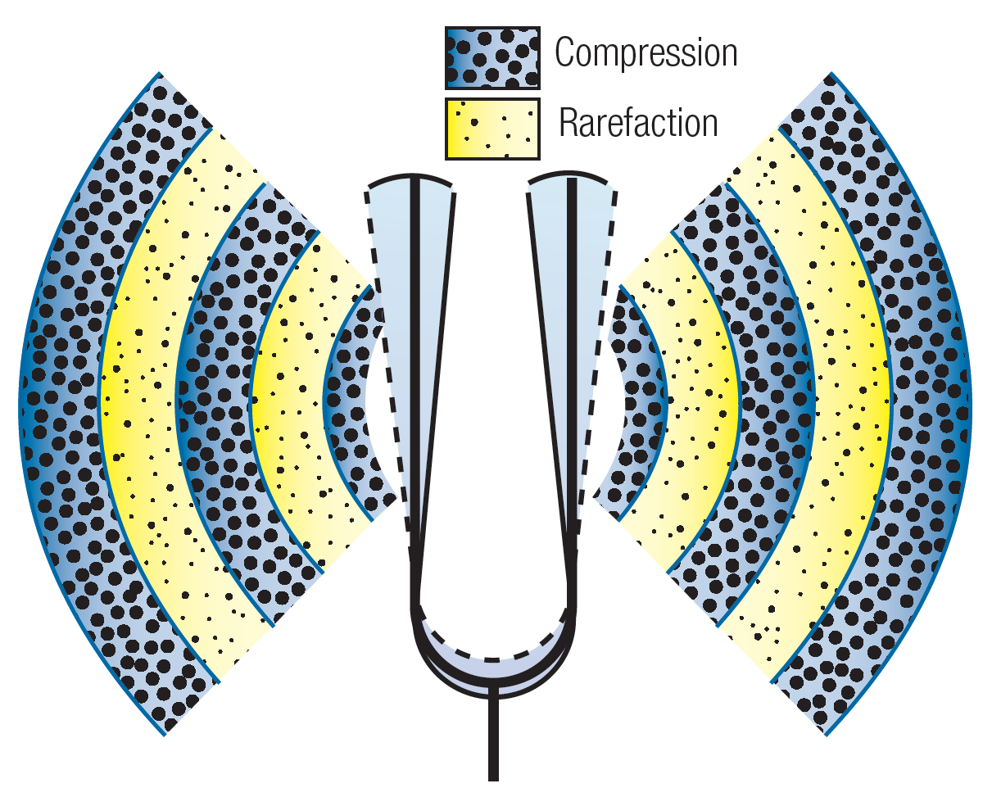
Nature of the Sound Stimulus
“Sound” is the rhythmic compression and decompression of the air around us caused by a vibrating object.
Applet
Applet2

Slide 3
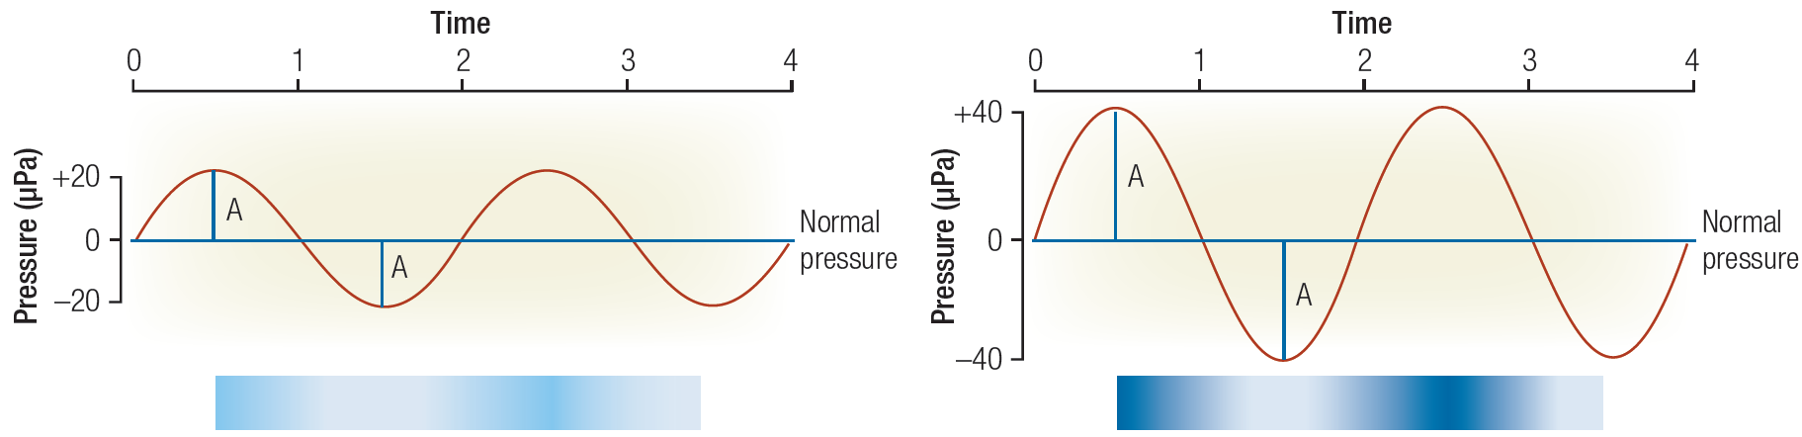
Sound Wave: Amplitude and Frequency (Hz)
Sound Pressure is measured in units called Pascals
1 Pascal (Pa) = 1 Newton of force/m²
1 atmosphere = 100,000 Pa
Human absolute hearing threshold = 0.00002 Pa = 20 microPa
(i.e., 2 ten billionths of an atmosphere)
Frequency measured in cycles/sec = Hertz (Hz) Nominal range of sensitivity: 20 – 20,000 Hz

Slide 4
The “decibel” (dB)
The decibel is a logarithmic unit used to describe a ratio (i.e., log (x/y))
In engineering analyses, it is used to normalize “power” measurements
to a known reference and then compresses the resulting ratio using
a log₁₀ operation.
This format is convenient for engineering analyses involving
wide dynamic ranges (when very small and the very large
magnitudes must be considered simultaneously).
dB = 10 log(Observed Power / Reference)

Slide 5
dB_{SPL}
The transducers (microphones) on sound level meters measure sound pressure (i.e., N/m² or Pascals).
Pressure needs to be converted to power prior to calculation
of the decibel equivalent….i.e., acoustic power = pressure²
Finally, we need to agree upon a Reference value.
By convention, we use 20 microPa (i.e., the hearing threshold)
Thus:
dB = 10 log (Observed Pressure² / 20 microPa²)
However……..

Slide 6
dB_{SPL} (continued)
Prior to the advent of hand-held calculators and computers
(circa 1970), performing a squaring operation was computationally expensive and prone to error.
To reduce computational demands, hearing science adopted a somewhat confusing convention in the specification of the
dB_{SPL} unit:
dB_{SPL} = 20 log (Observed Sound Pressure / 20 microPa)
+6 dB_{SPL} = doubling sound pressure +20 dB_{SPL} = 10x pressure
-6 dB_{SPL} = ½ sound pressure -20 dB_{SPL} = 1/10 pressure

Slide 7
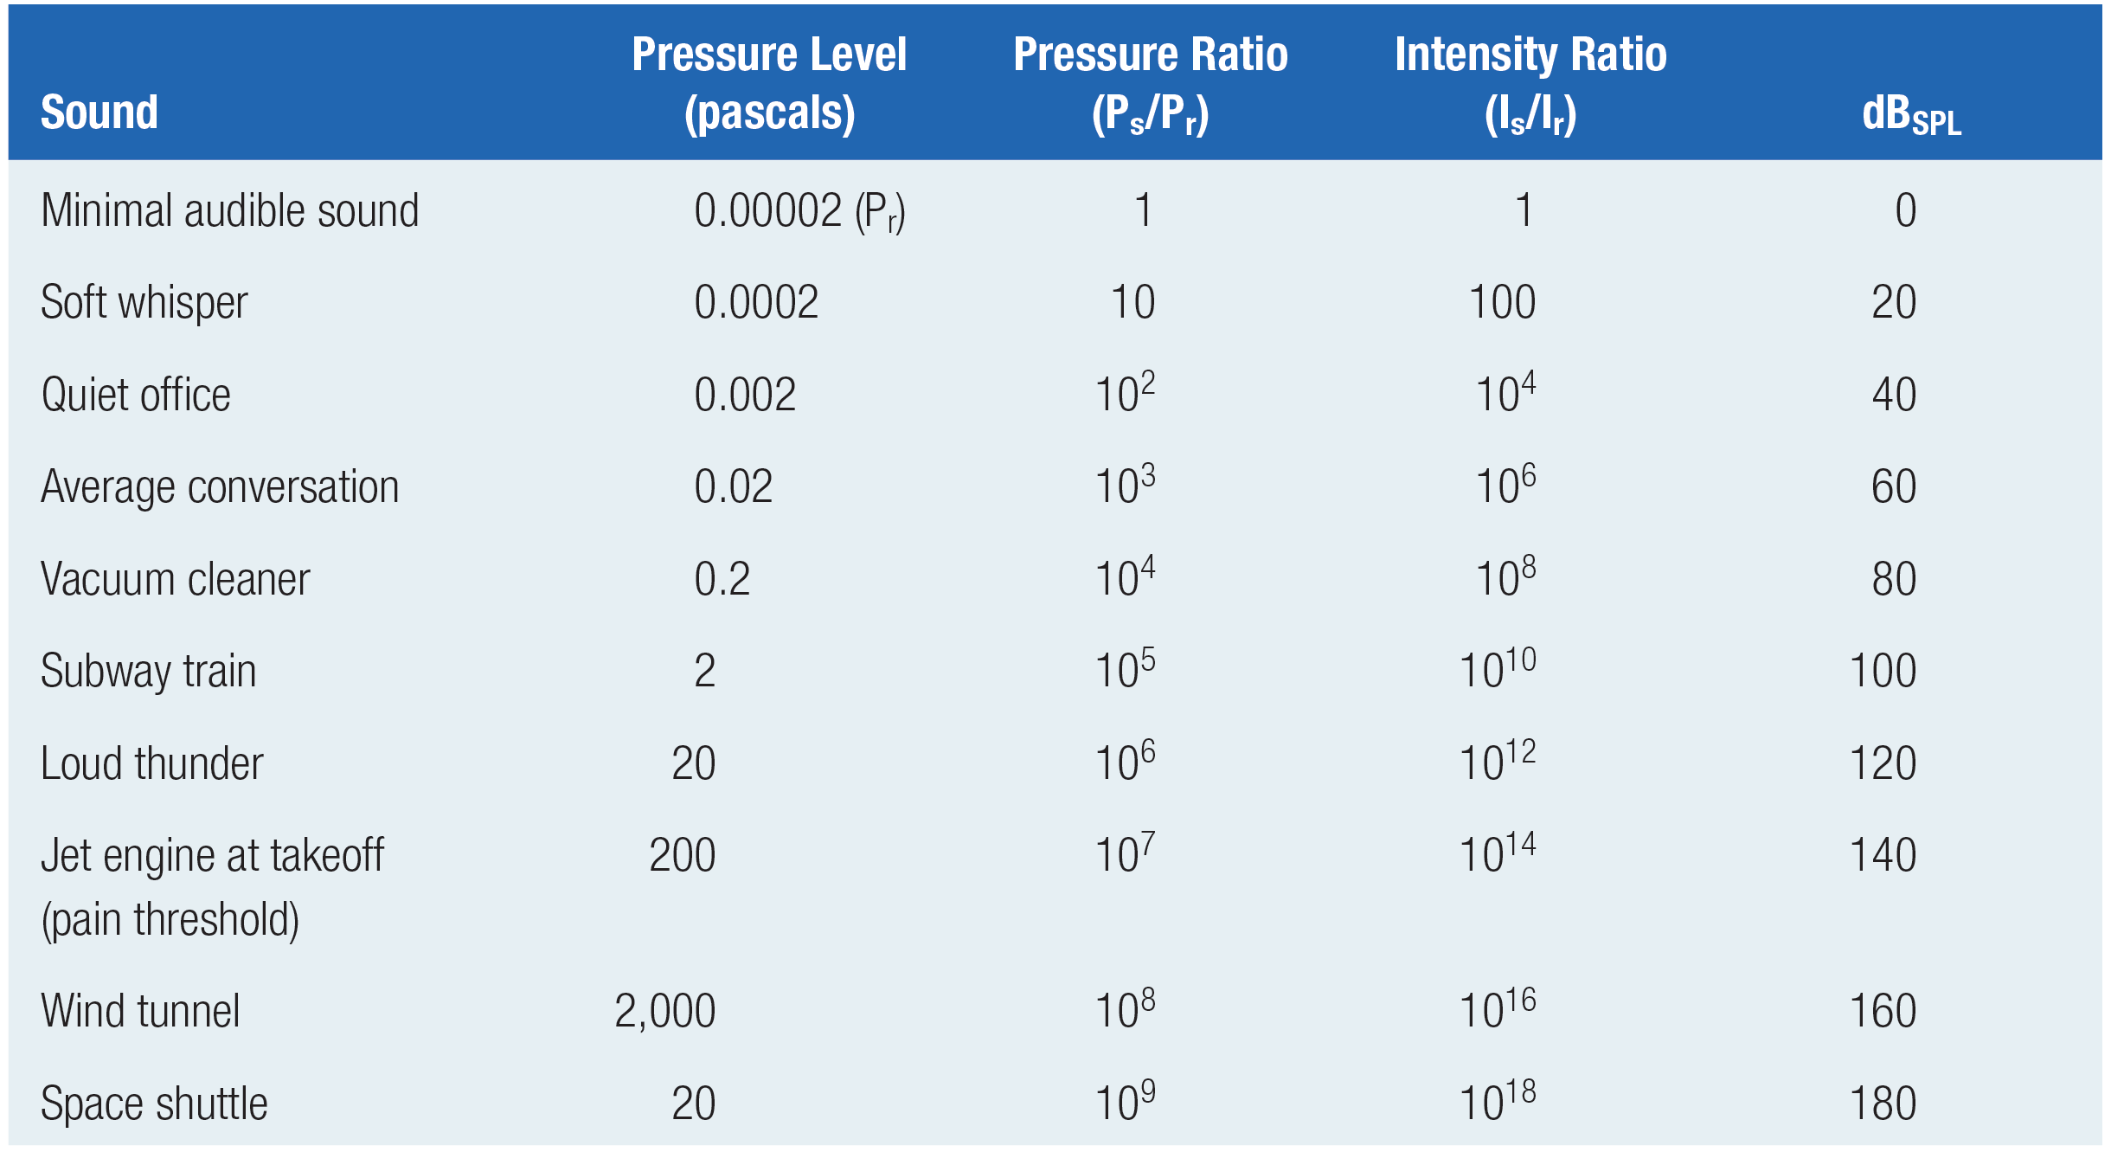
Some Typical Sound Amplitude Values

Slide 8
More about those pesky decibels
JND for sound intensity is about 1 dB_{SPL} for most of normal range of hearing
What does 0 dB_{SPL} mean? Hint: 20 log (20 microPa/20 microPA) = 0 dB_{SPL}
If one machine emits 80 dB_{SPL} then how much sound amplitude would be expected from two machines side-by-side?
2 x 80 = 160 dB_{SPL} ??? (That’s pretty intense)
Convert from dB_{SPL} back to raw pressure, sum the pressures, then convert sum to dB_{SPL} 80 dB_{SPL} → antiLog(80/20) → 10,000
20 log (10,000+10,000) = 86 dB_{SPL} (approx.)

Slide 9
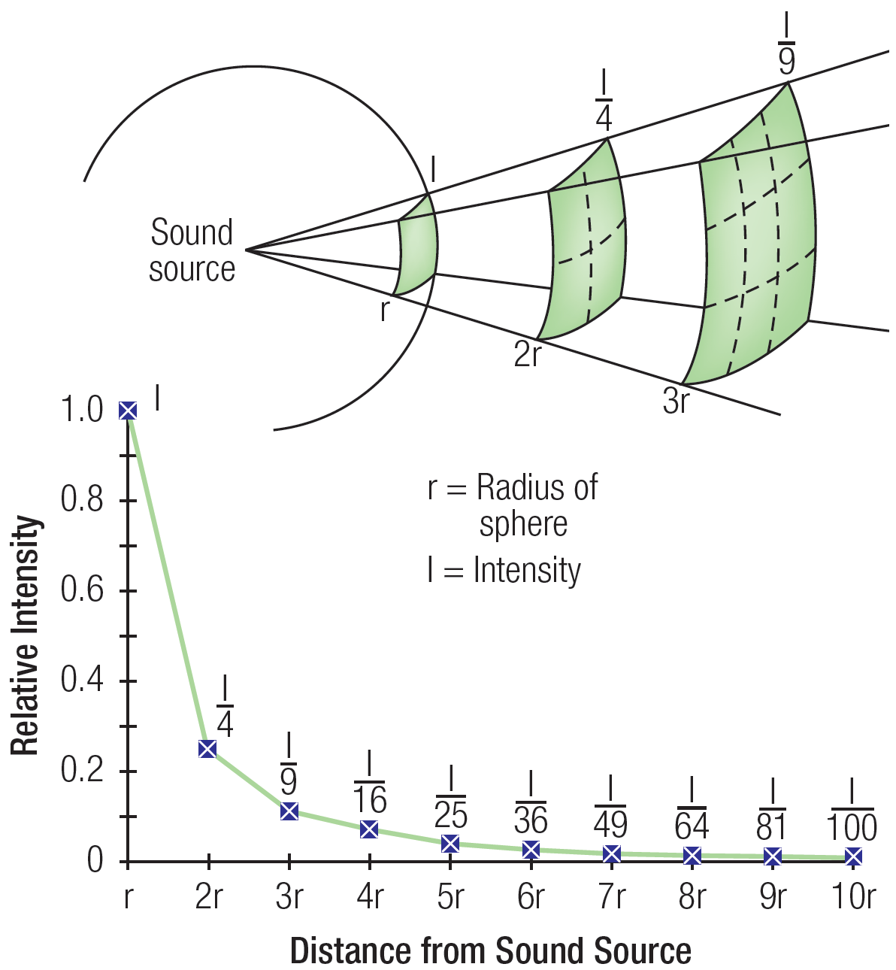
Inverse-Square Law
Area of sphere = 4πr²

Slide 10
A “Better” Sound Amplitude Table?
dB_{SPL}
Loud hand clapping at 1 m distance
Siren at 10 m distance
Hand (circular) power saw at 1 m
Very loud expressway traffic at 25 m
Lawn mower at 10 m
Refrigerator at 1 m
Talking; Talk radio level at 2 m
Very quiet room fan at low speed at 1 m
Normal breathing at 1 m
0 Absolute threshold

Slide 11
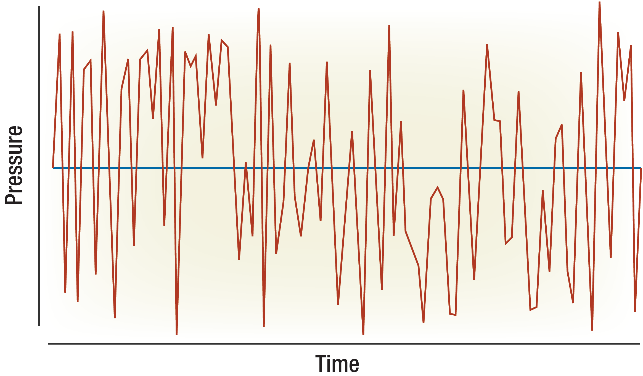
Most Sound Stimuli are Complex

Slide 12
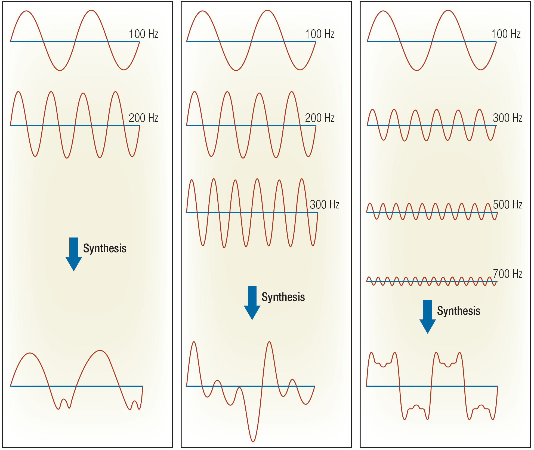
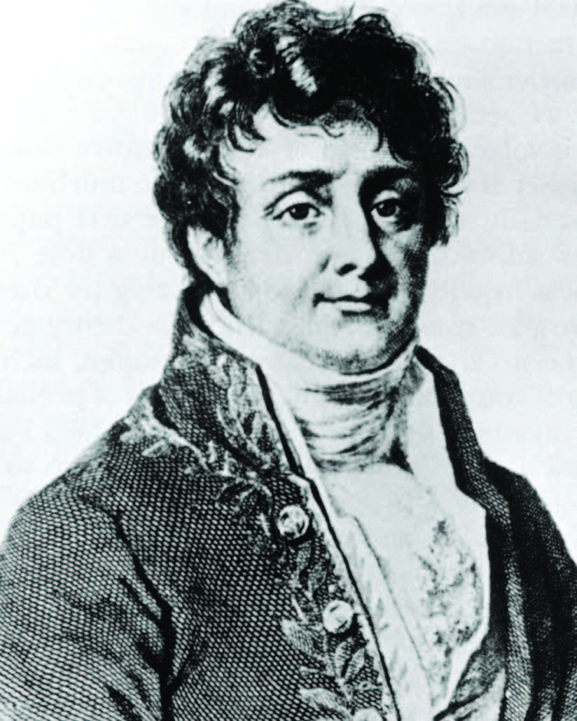
Complex Sound = Sum of Sines (Fourier Theorem Revisited)
J.B.J. Fourier
(1768-1830)
Beats Applet
Fourier Sound Applet

Slide 13
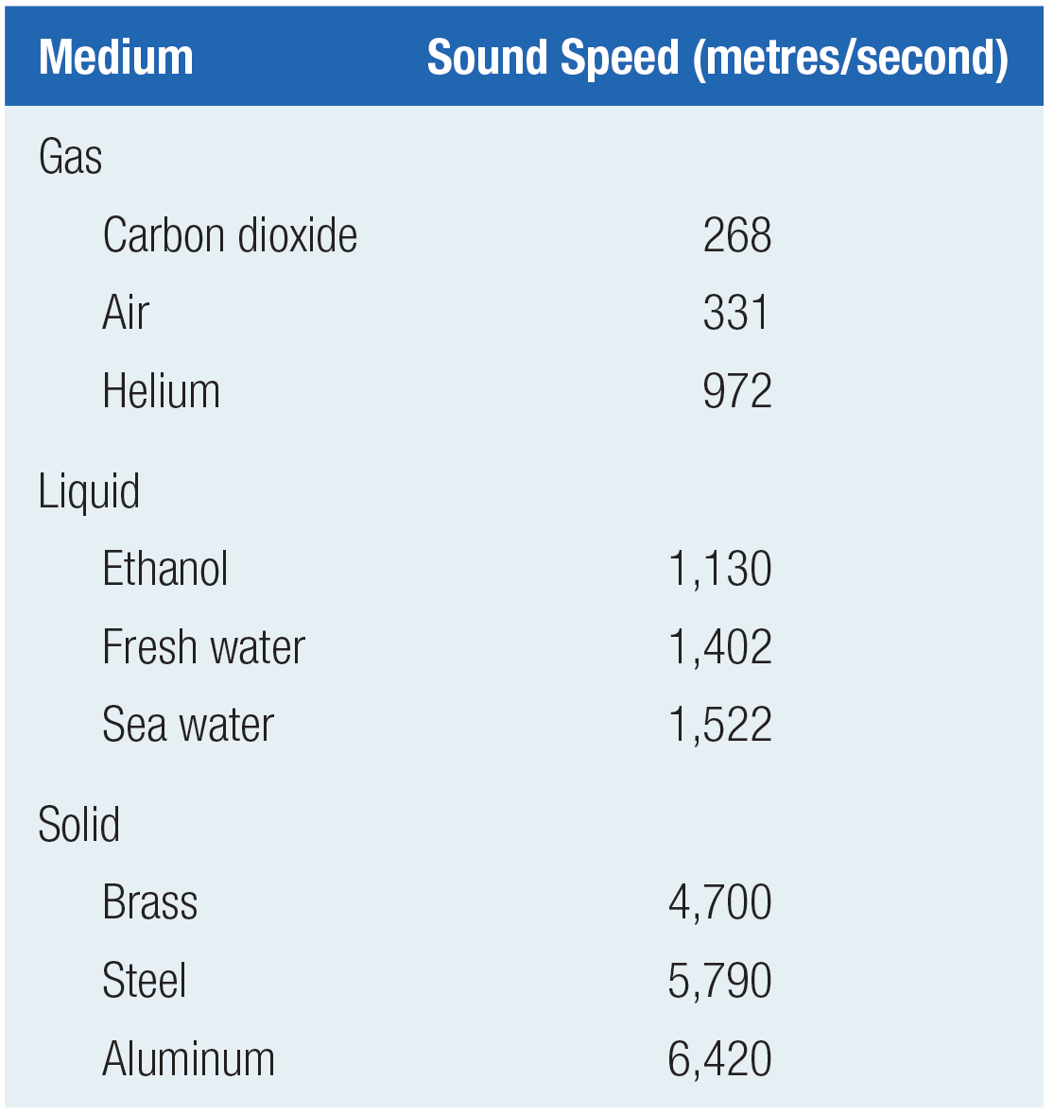
Speed of Sound
Acoustic energy results from a
traveling wave of rhythmic “compression” through a physical medium (e.g., air; water; steel).
It is the “compression” that travels not the medium, per se.
The characteristic speed of this travelling wave varies as a function of the medium (elasticity; density).
The speed of acoustic energy through the air (aka “sound”) is
331 m/sec (or 742 MPH) at 0-deg C
(Faster at higher temperatures).

Slide 14
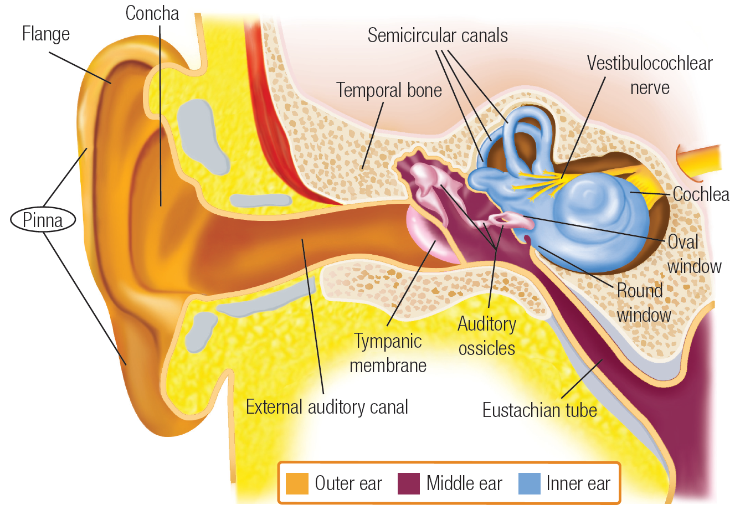
Gross Anatomy of the Ear

Slide 15
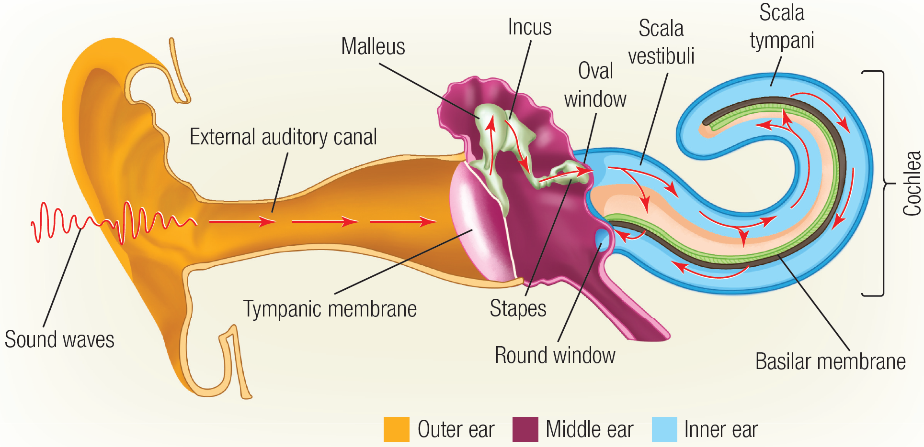
Flow of Acoustic Energy (The “Impedance Problem”)

Slide 16
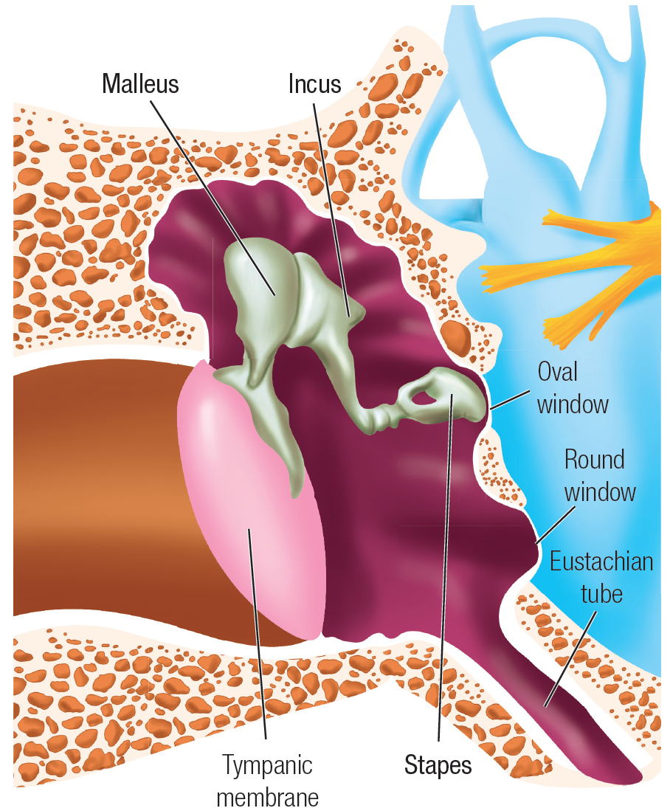
The “Impedance Problem”
99.9% of sound energy in the air is reflected at the air:water boundary (10 log(0.1/100)) = -30 dB loss) (1/1000x)
How does the ear compensate for this loss as sound energy is transmitted from the air to the fluid that filled the cochlea?
2 dB gain via ossicular leverage (1.6x)
25 dB gain via surface area condensation
(eardrum → stapes) (316x)
~5 dB gain at mid-frequencies (3x) due to pinna and auditory canal resonance

Slide 17
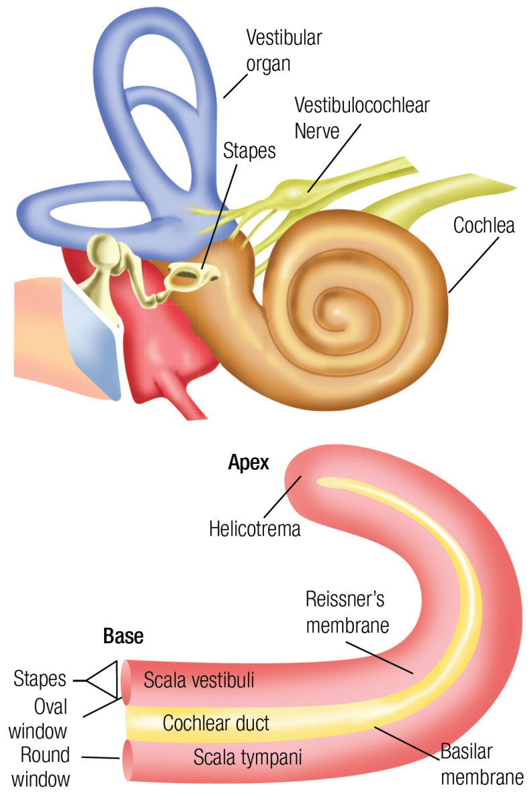
The Cochlea

Slide 18
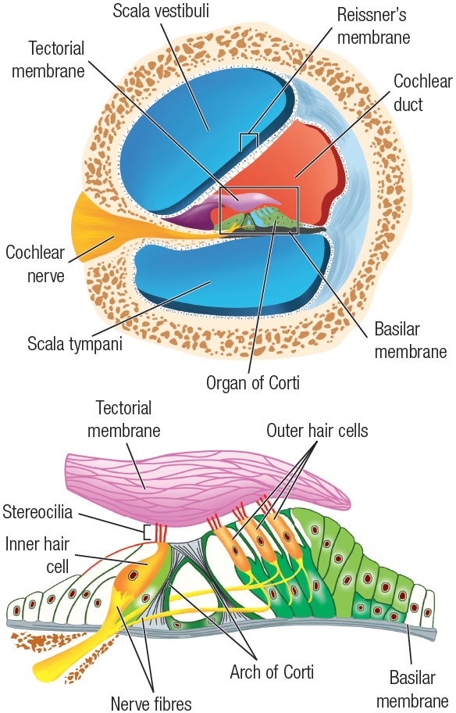
The Organ of Corti
3000-3500 Inner Hair Cells (IHC)
12,000 Outer Hair Cells (OHC)

Slide 19
Auditory Transduction

Slide 20
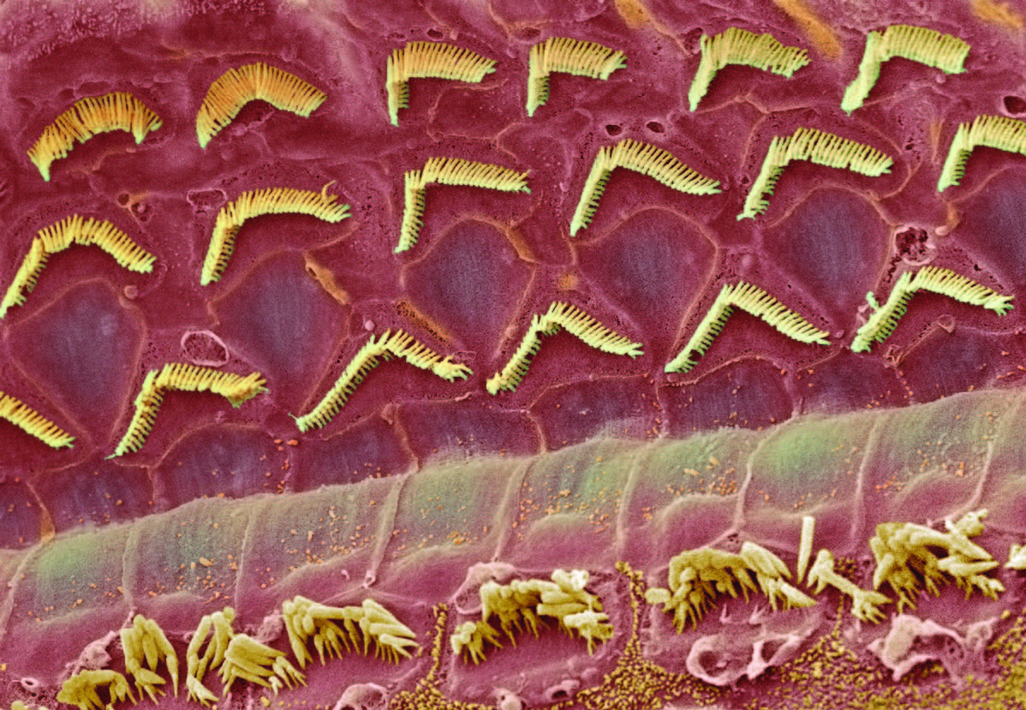
Photomicrograph: Sensory Hair Cells
Three rows of
Outer Hair Cells
One Row of Inner Hair Cells

Slide 21
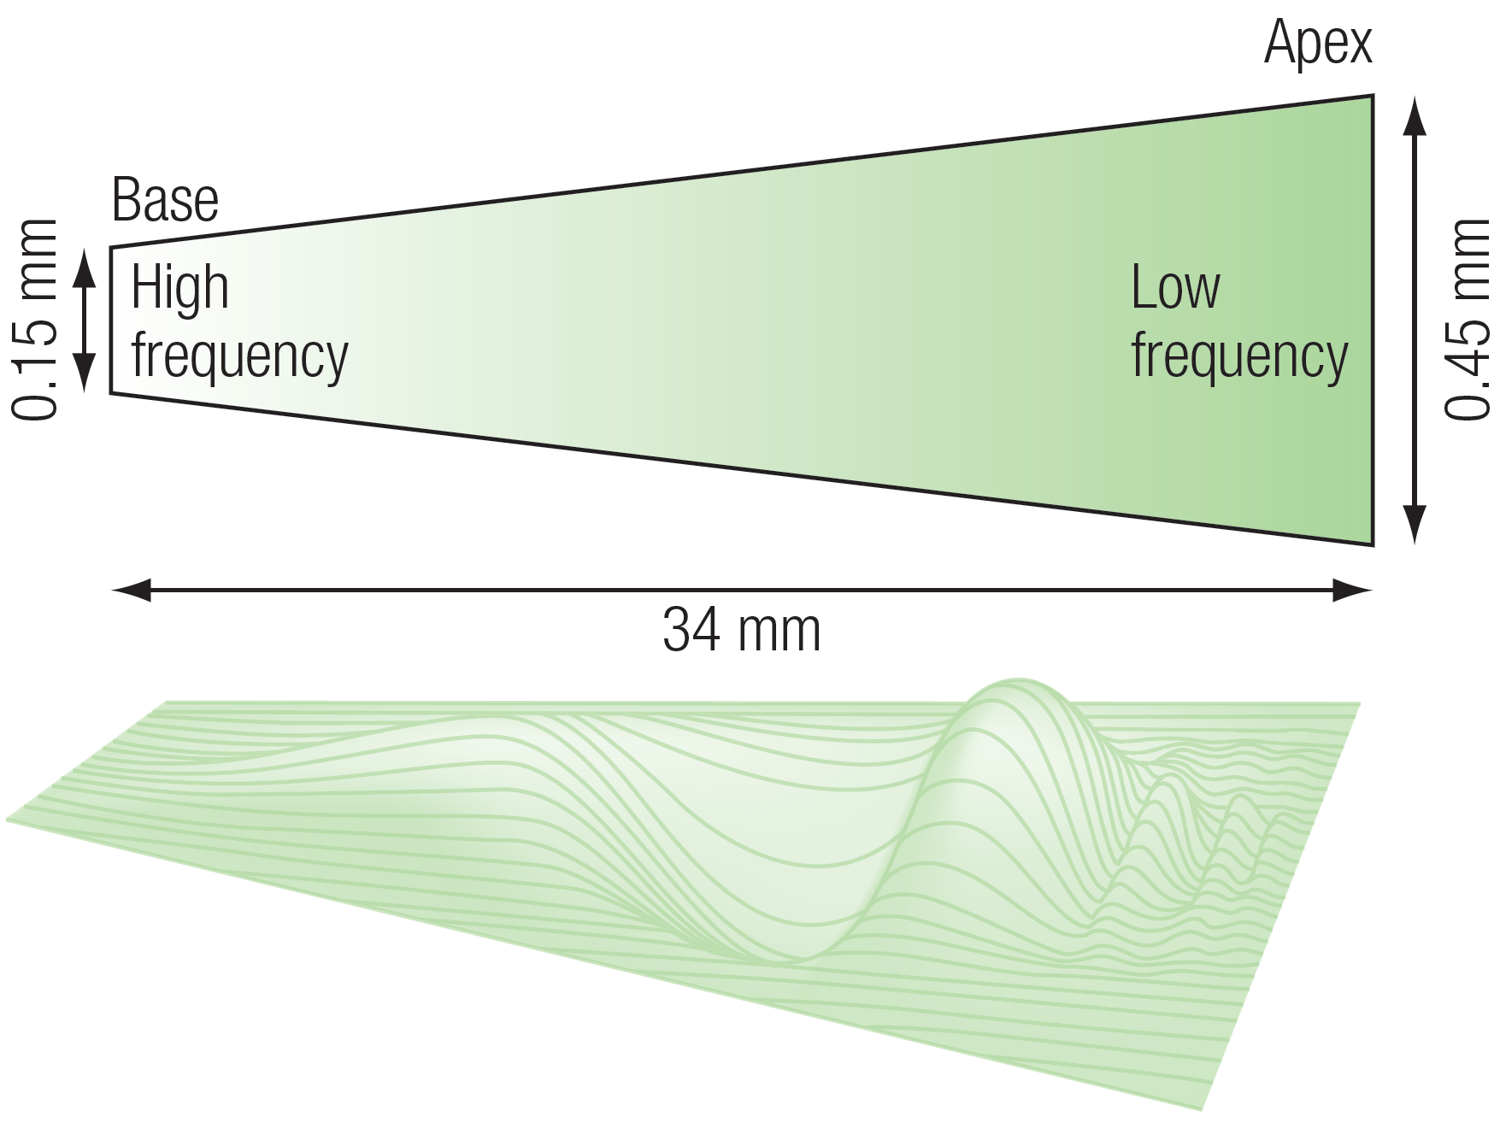
Basilar Membrane Response to Pure Tone Stimulus

Slide 22
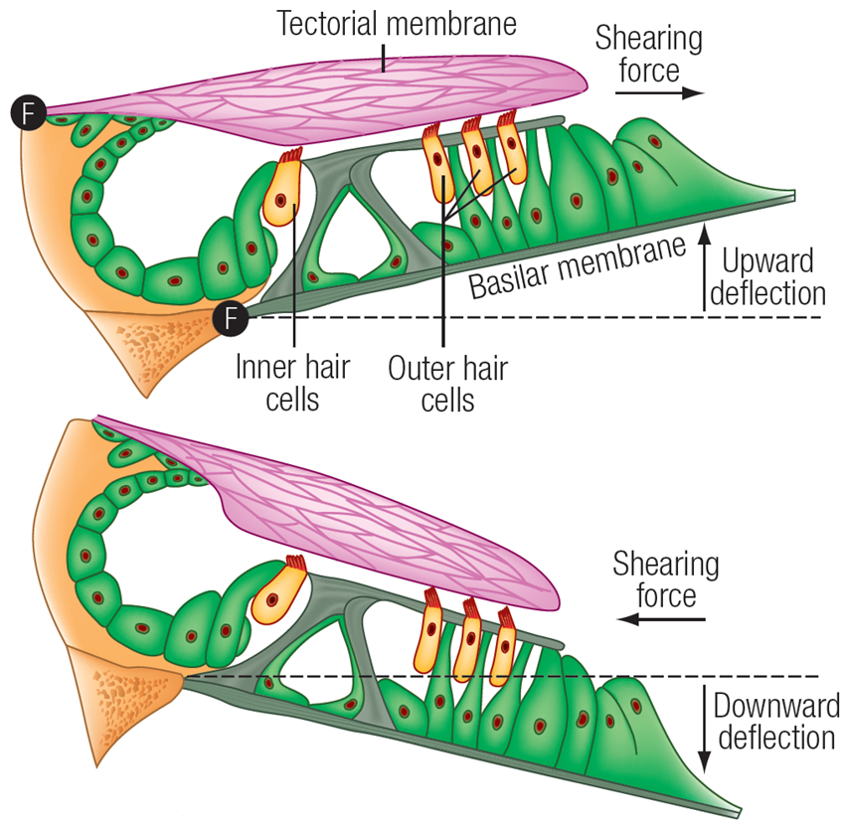
Basilar Membrane Modulation Effects upon Sensory Hair Cells

Slide 23
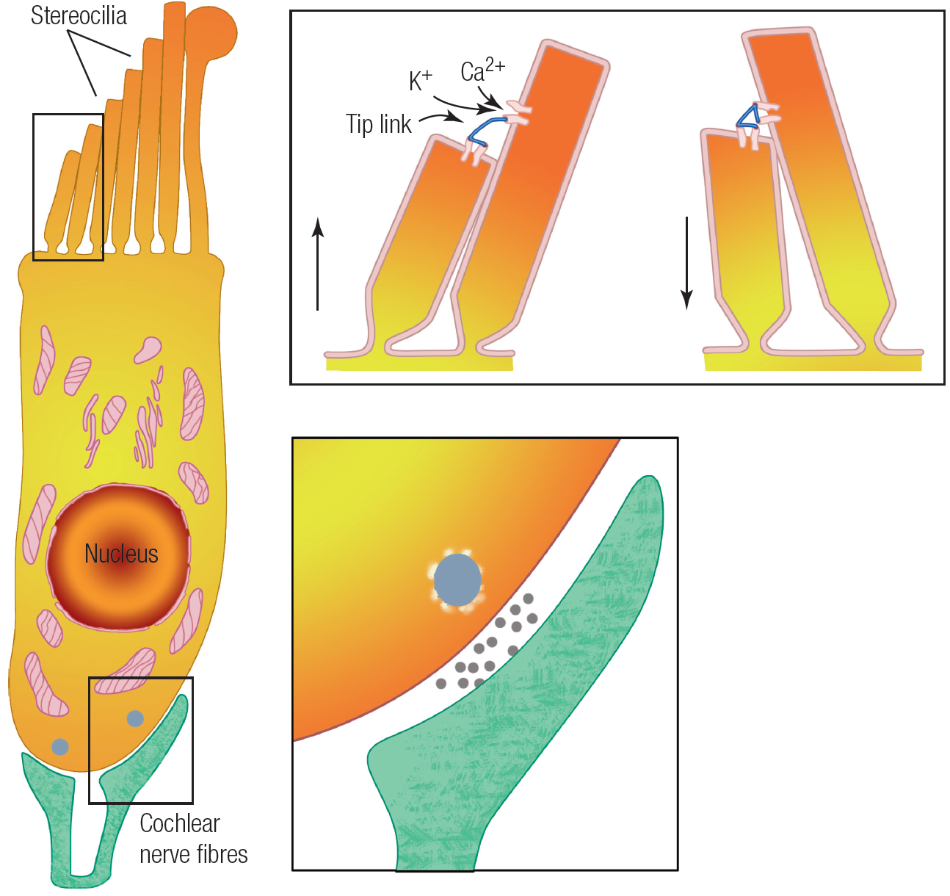
IHC Stereocilia “Tip Links”
“tip link” connects gate to adjacent cilia.
Shearing motion forces gate to open.
Mechanical open-and-close of
gate modulates influx of potassium ions (FAST).
K⁺ depolarization of IHC triggers release of glutamate at cochlear nerve fiber synapse.

Slide 24
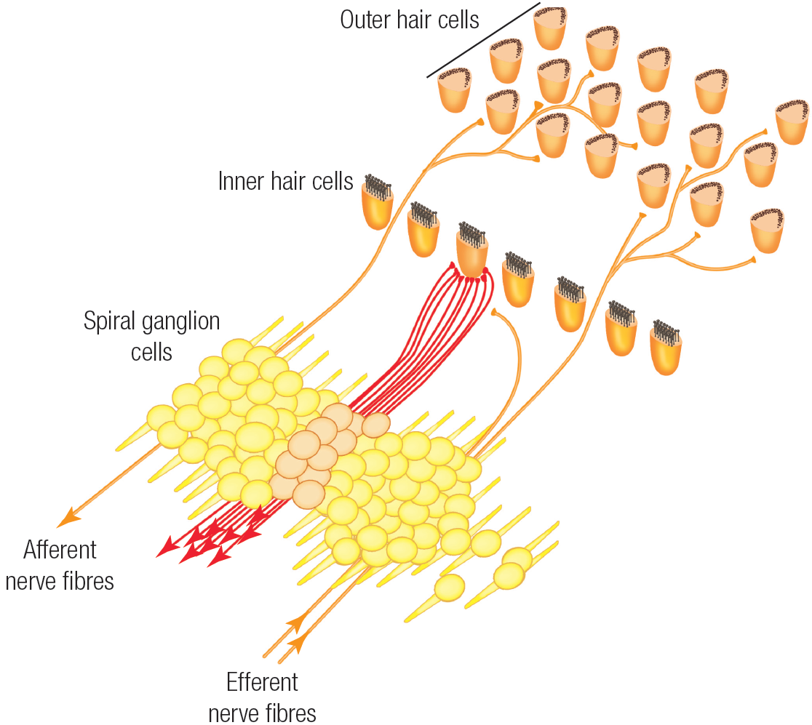
Innervation of IHCs/OHCs
30K+ fibers in cochlear nerve. Nearly 10:1 fiber-to-IHC innervation ratio.
Sparse number of fibers carry info from OHC to brain.
Small number of fibers descend from brain to OHCs.
Role of OHC’s?

Slide 25
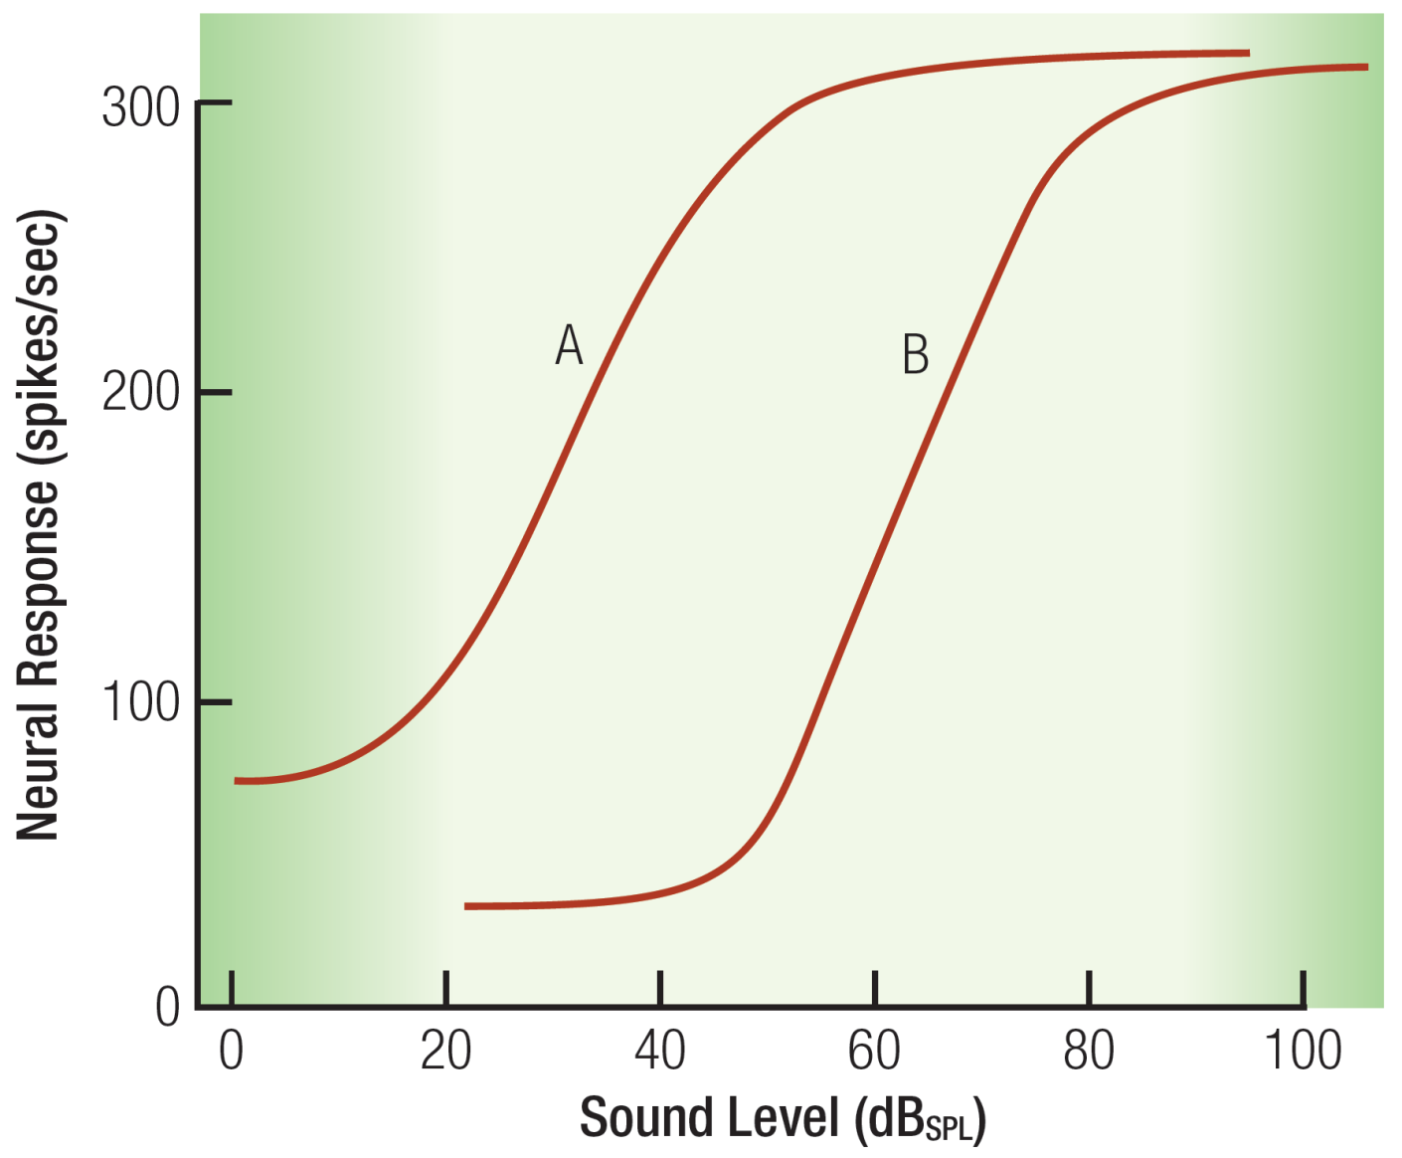
Amplitude Coding (“Divide and Conquer”)
Multiple nerve fibers for each IHC.
Each nerve fiber tuned to a different 40 dB “range” of stimulus intensity.

Slide 26
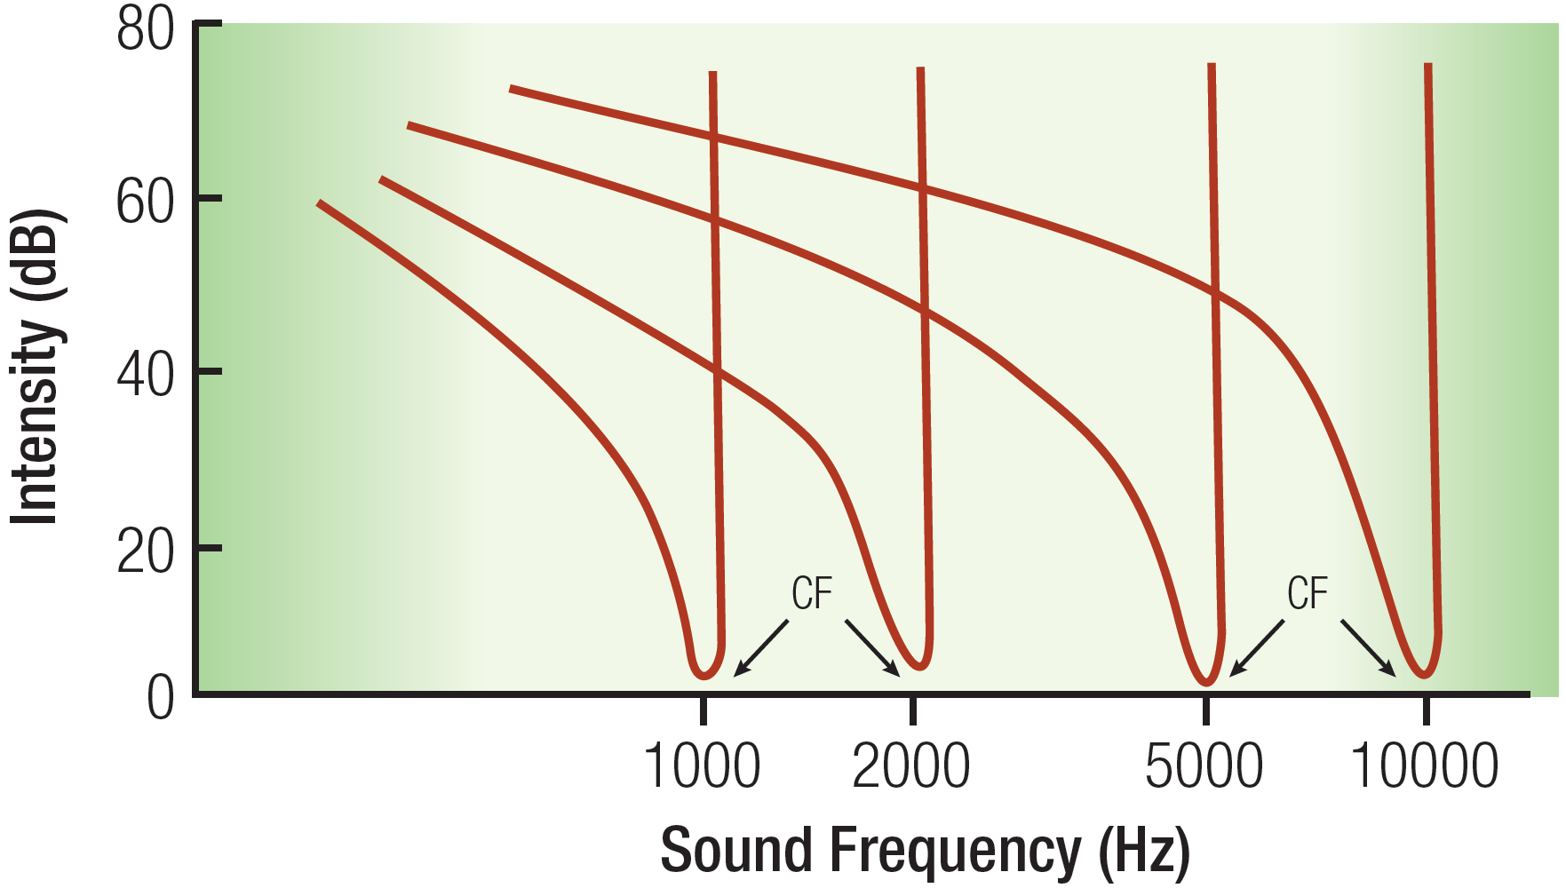
Asymmetrical Frequency Tuning of Cochlear Nerve Fiber “Thresholds”
(Physiological basis for frequency-specific response explained below)

Slide 27
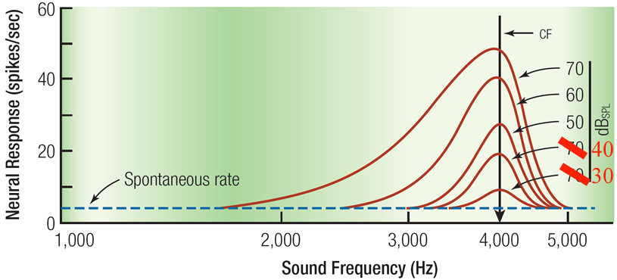
Tuning Specificity of Cochlear Nerve Fibers “Broadens” with Increased Intensity
Q: Why the broadening and asymmetry? ~A: Look to the Basilar membrane

Slide 28
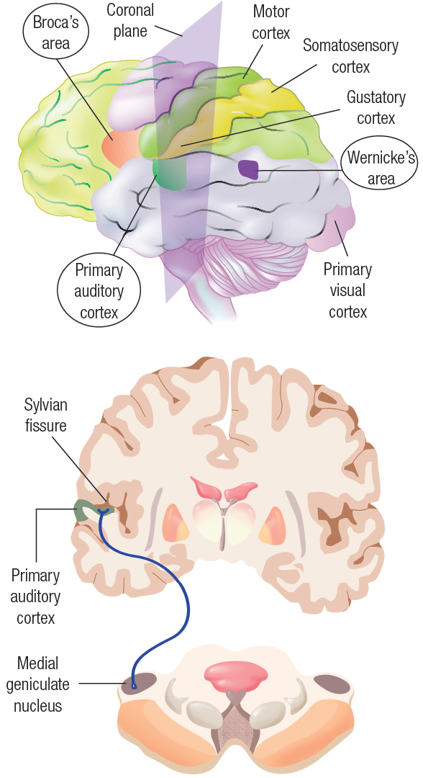
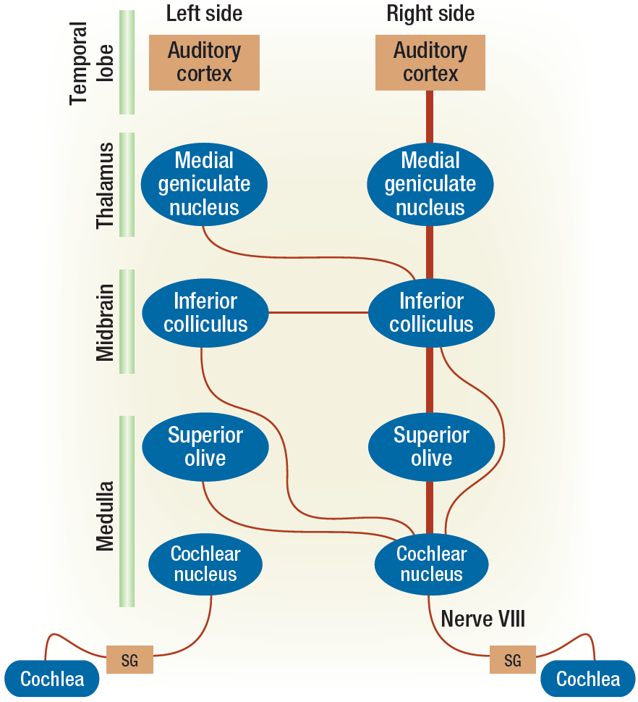
Ascending Pathways
Asymmetry

Slide 29
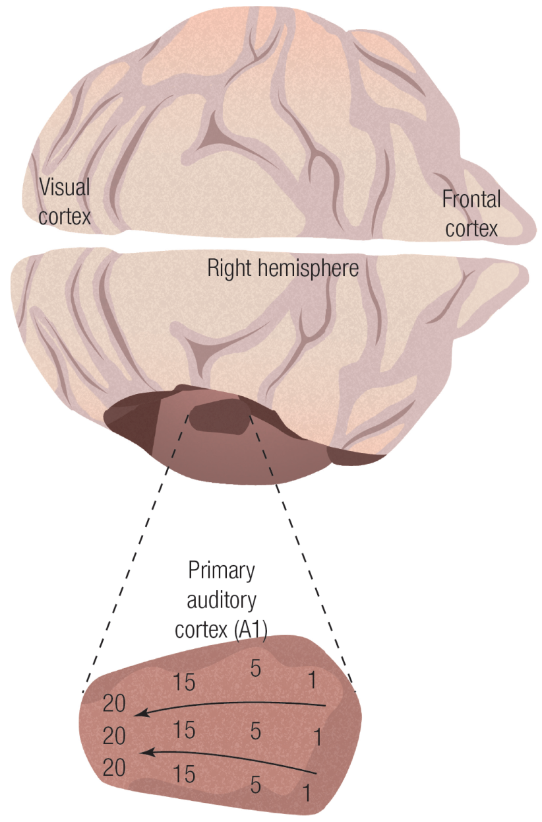
Tonotopic Organization of Primary Auditory Cortex (A1)
Also note:
Segregation of monaural versus binaural cells is maintained.
Binaural cells loosely organized according to spatial location of stimulus source.

Slide 30
Auditory Frequency Coding

Slide 31
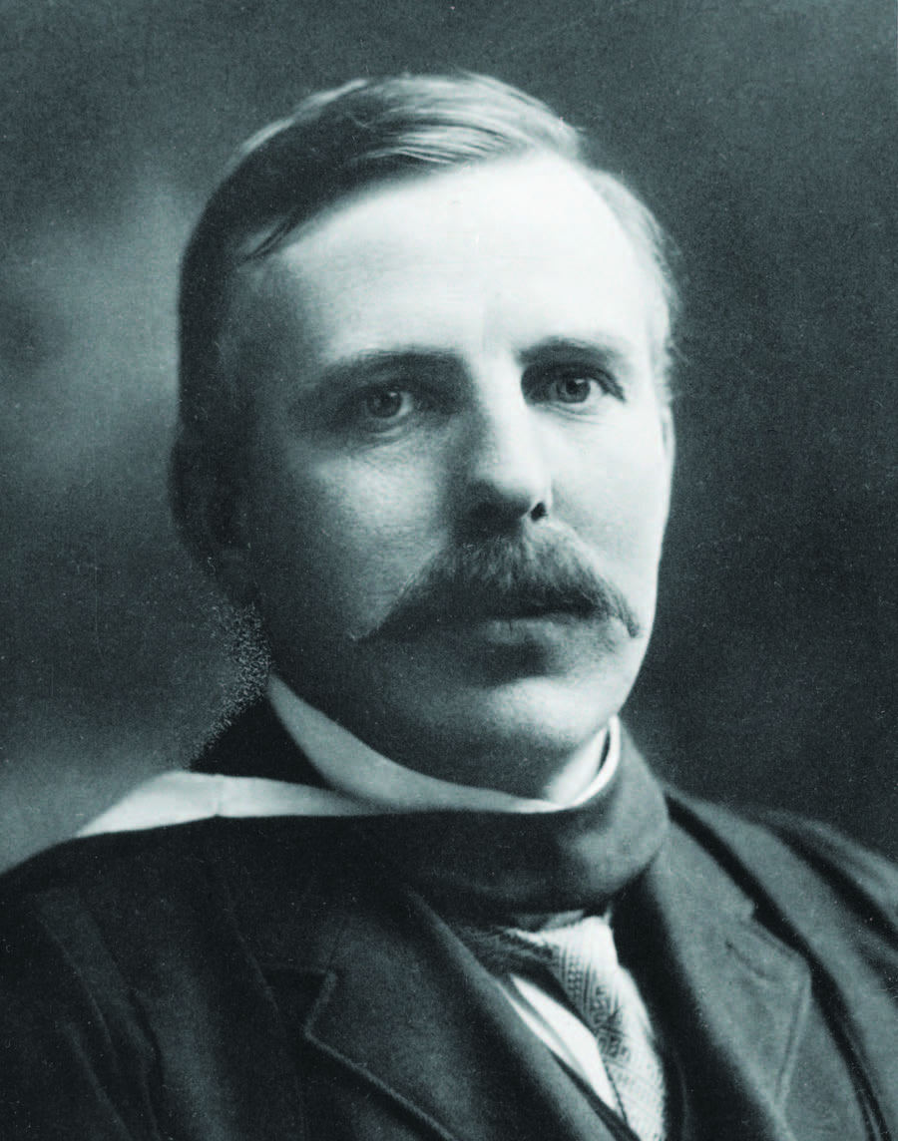
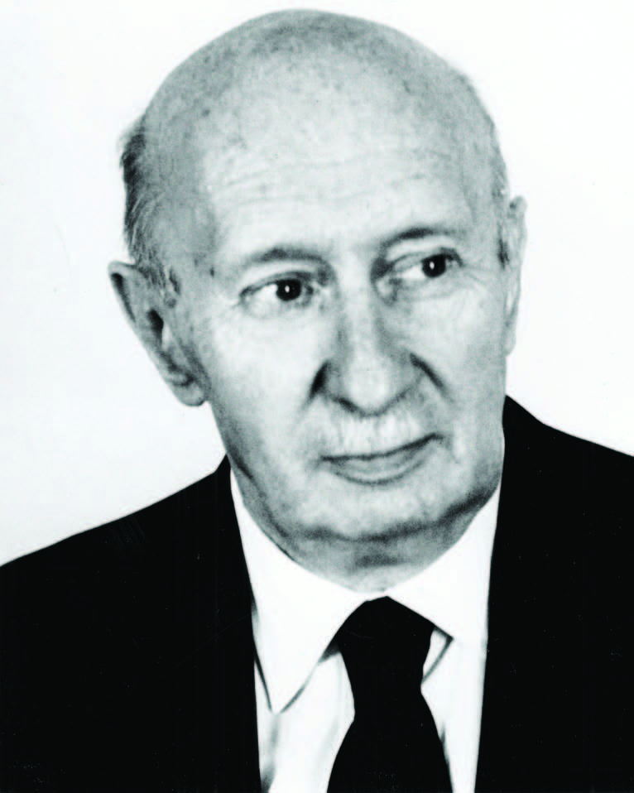
Frequency Mechanism versus Place Mechanism
Frequency Theory
Place Theory
Ernest Rutherford
(1871-1937)
Georg von Békésy
(1899-1972)

Slide 32
Frequency Theory (Rutherford)
Basilar membrane analogy to microphone diaphragm
Each oscillation yields nerve pulse
Problem: Max. neural response approx. 500 Hz
Solution: Time division multiplexing (aka “Volley Principle” ) Supported by “cochlear microphonic” (Wever & Bray; but consider Botox results)

Slide 33
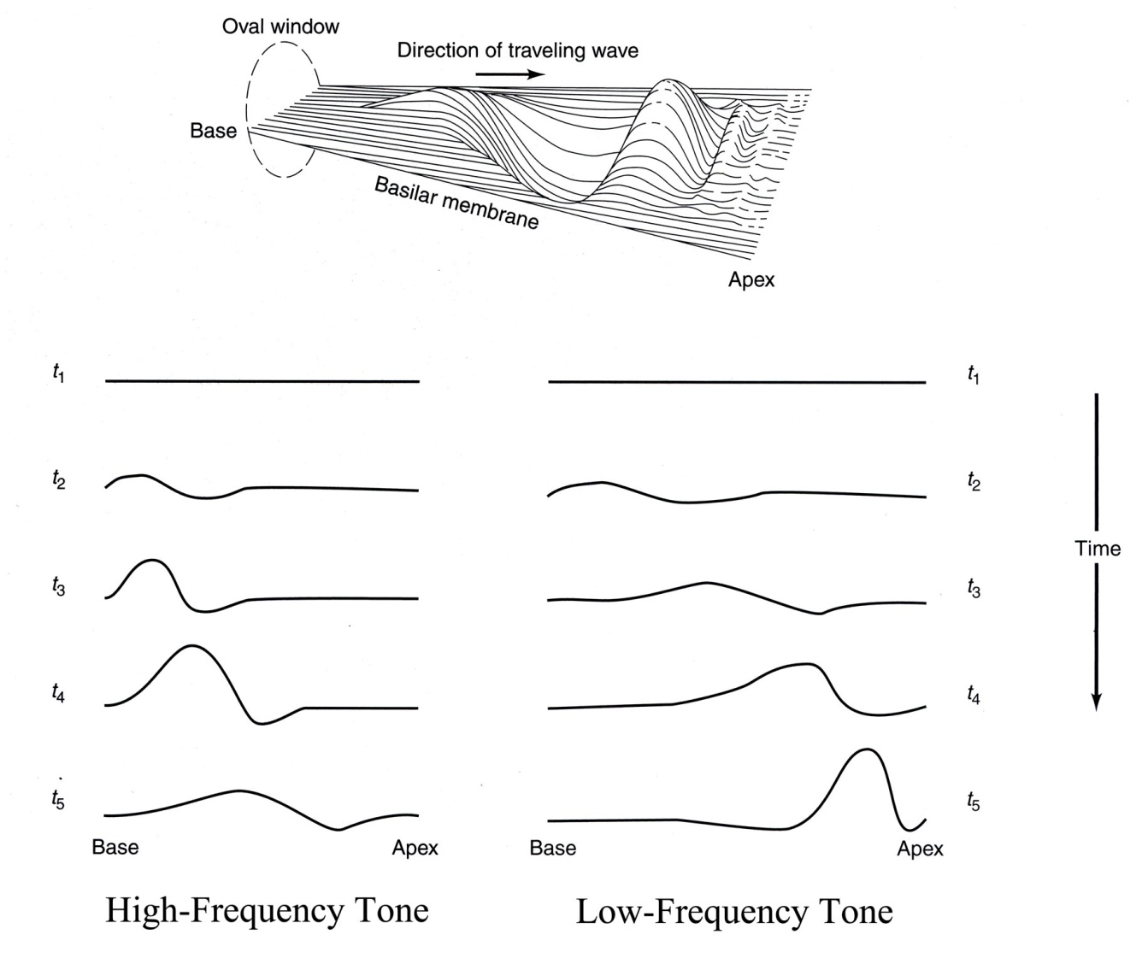
von Békésy Place Theory: Focus on Basilar Membrane Dynamics

Slide 34
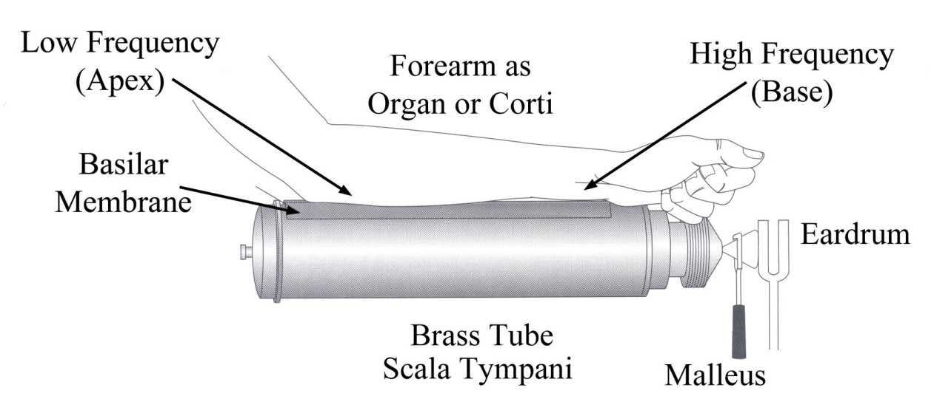
The Simple Beginnings for von Békésy’s Nobel Prize

Slide 35
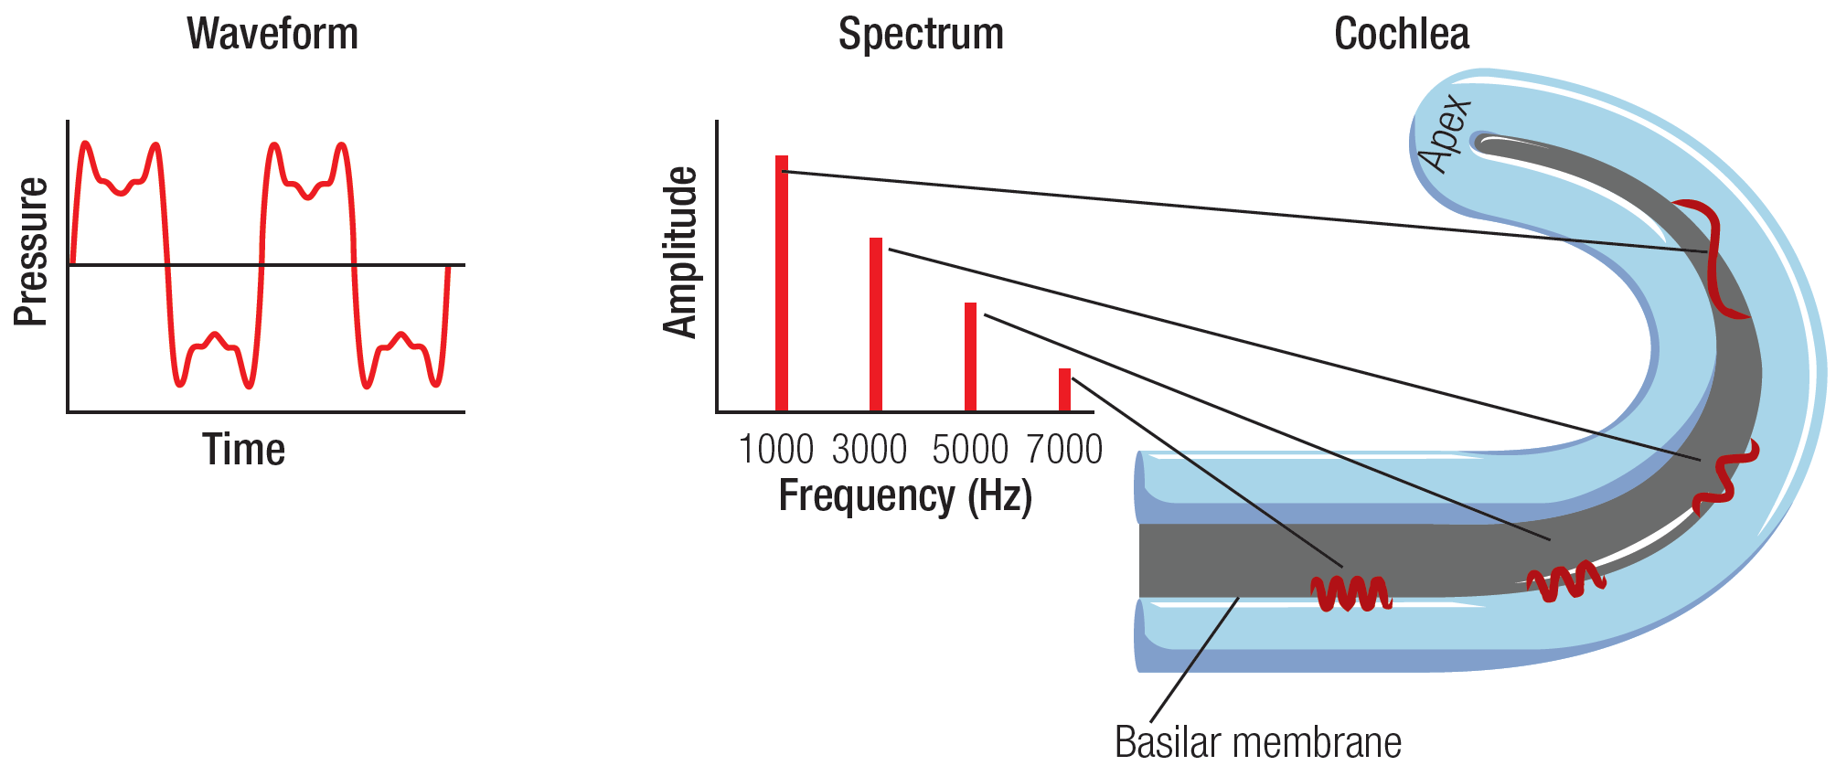
Von Békésy’s “Place Mechanism” as Biological Fourier Analyzer
Basilar Membrane Dynamic Simulation (animation)

Slide 36
Functional Aspects of Hearing

Slide 37
Minimum Audibility Curve
Average detection threshold for 18-yr-olds for 1KHz tone at sea level is
20 microPa (μPa)

Slide 38
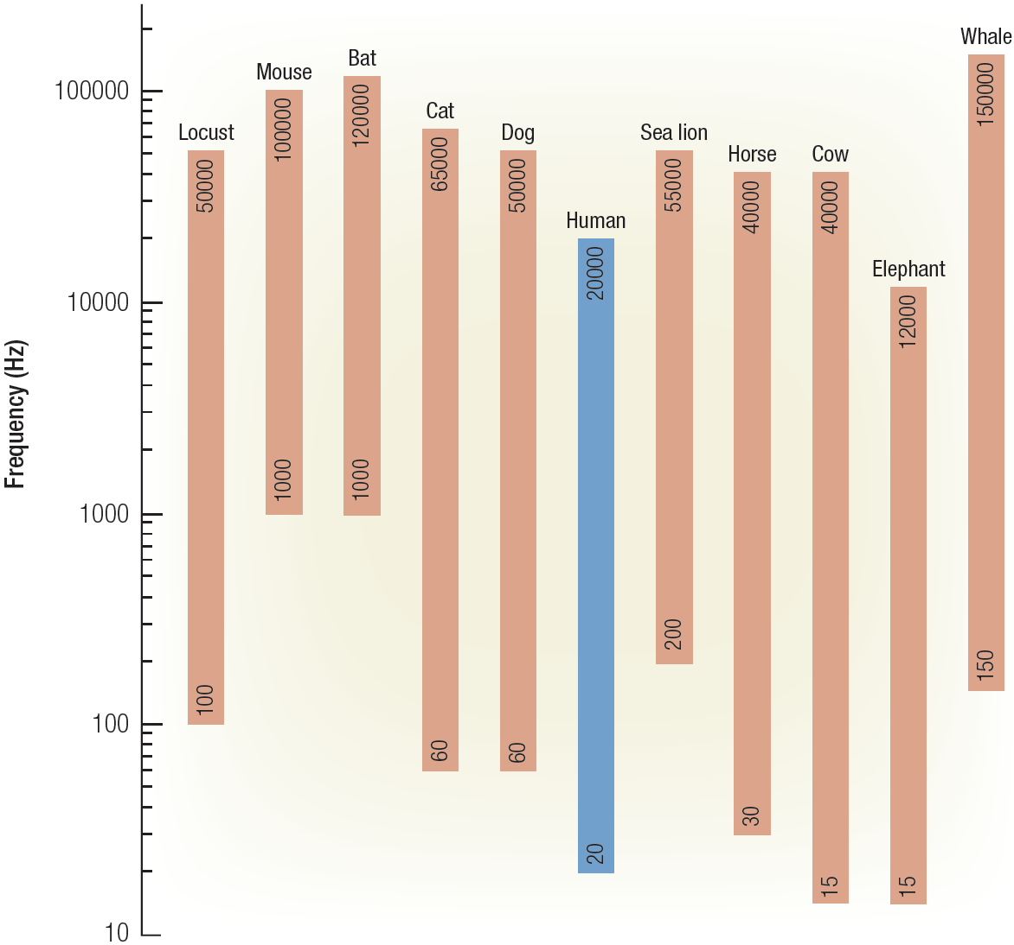
Species-Specific Frequency Range

Slide 39
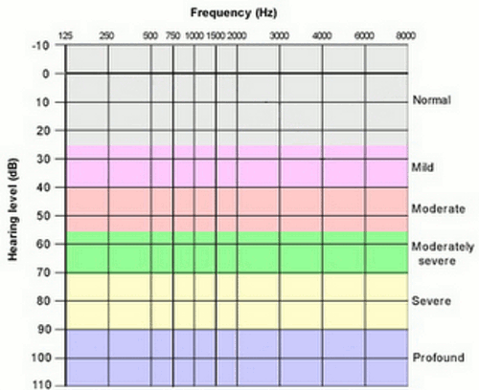
Clinical Audiogram (dB_{HL})
dB-HL (Hearing Level) uses a different reference level for each test frequency.
That reference level represents the average threshold (18 yr-olds)
demonstrated at that frequency.
Hence, a value of 0 dB-HL means “average” hearing level at the frequency under test.

Slide 40
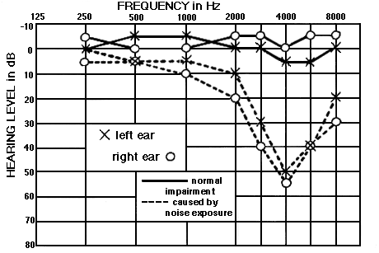
Normal vs. Noise-Induced Hearing Loss
Source: http://mustelid.physiol.ox.ac.uk/drupal/?q=acoustics/clinical_audiograms

Slide 41
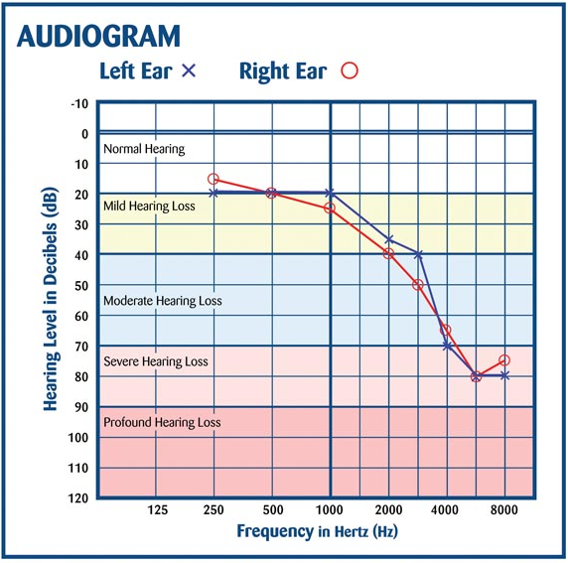
Age-related Hearing Loss (Presbycusis)

Slide 42
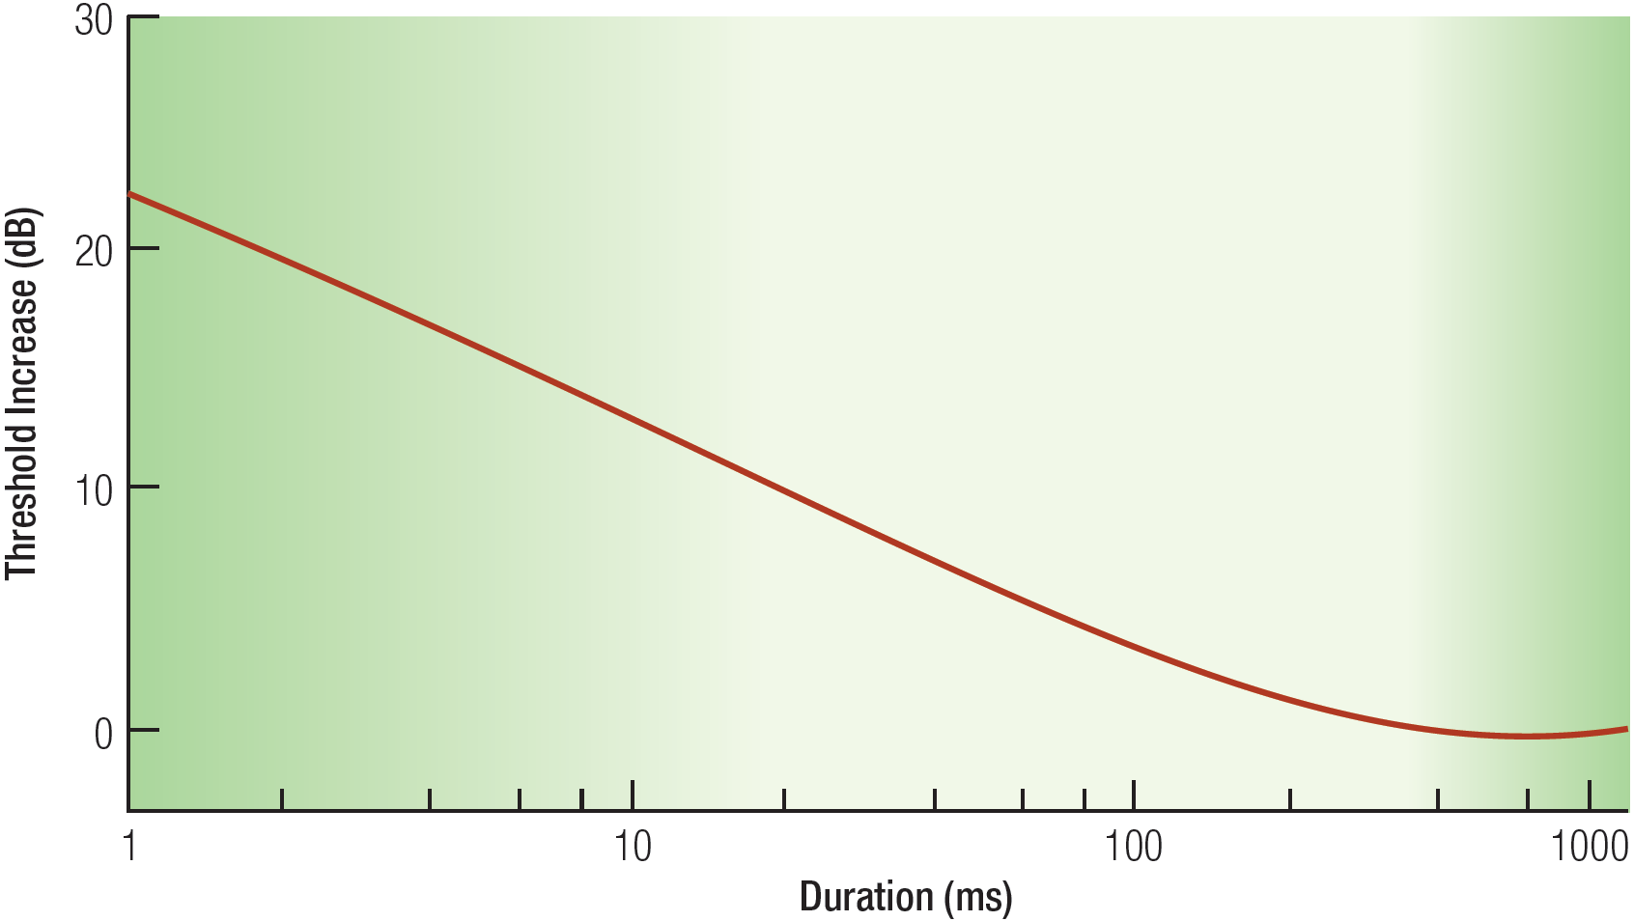
Auditory Summation Effect

Slide 43
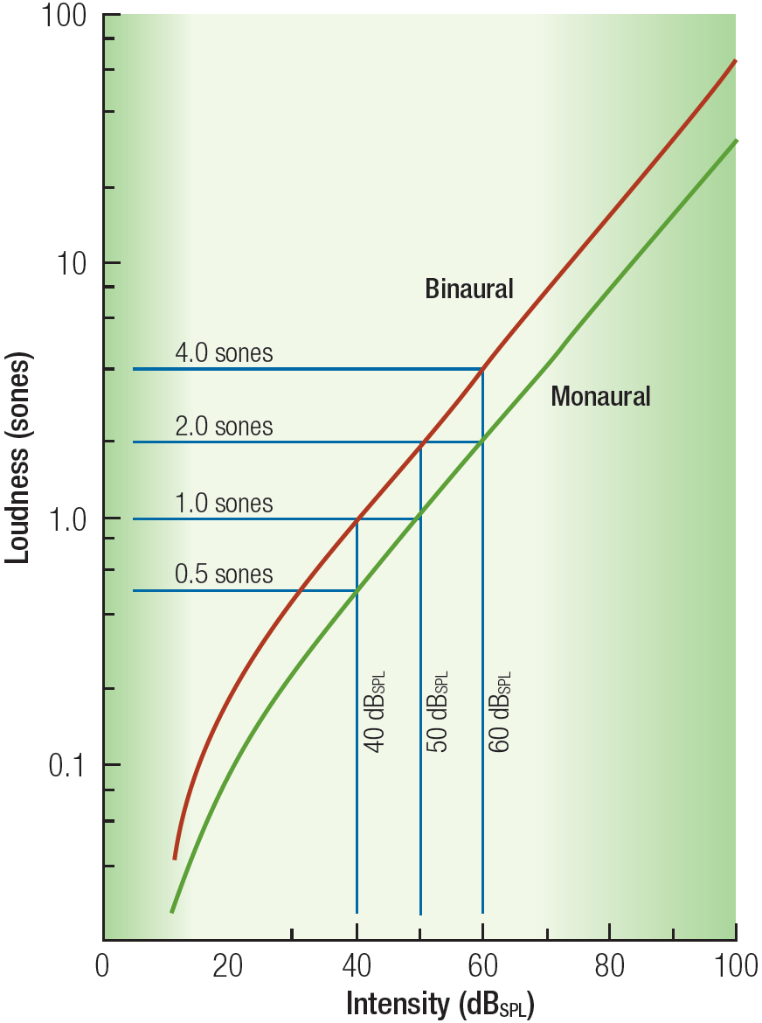
Loudness
The psychological magnitude of sound (i.e., “Loudness”) grows at a slower rate than the physical magnitude of the sound stimulus.
Using magnitude estimation techniques, S.S. Stevens has quantified this nonlinear relationship as:
L = K * P^{0.67}
L=loudness; P=sound pressure
Stevens’ Power Law; Linear in log-log plot; slope ≈ exponent
Doubling SP yields 60% ↑ loudness 3-fold increase in SP → 2X loudness

Slide 44
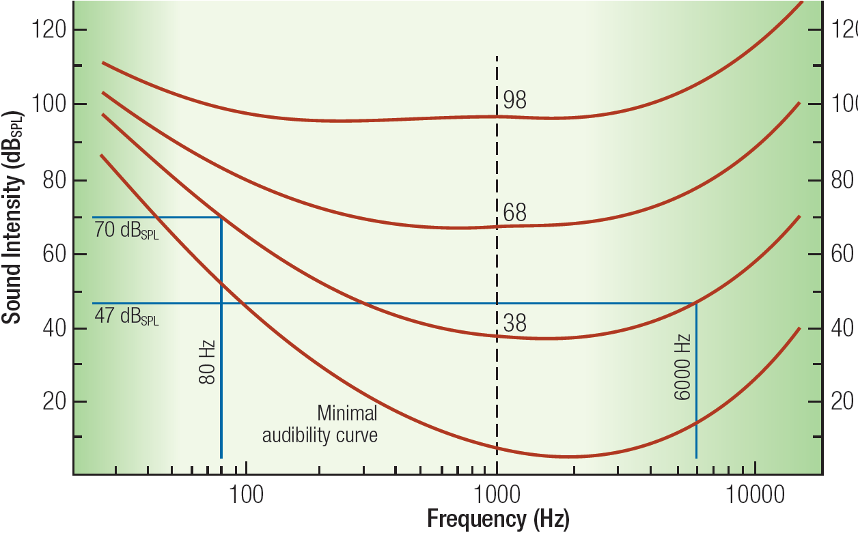
Equal Loudness Contours
Frequency differentiation is flattened at high amplitudes; Speech and music sounds “tinny” at high loudness levels; Remember change in cochlear nerve tuning at higher intensity levels.

Slide 45
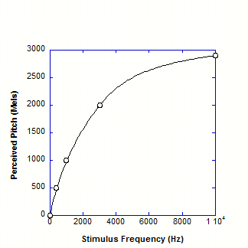
Pitch = f(Frequency) MEL Scale
Semi-Log Plot
Reference unit of perceived PITCH:
1000 Hz = 1000 Mels
Perceived pitch increases “linearly” with stimulus frequency below 4KHz; but grows at a much slower rate at 4KHz and above.
Linear Plot

Slide 46
Tonal Masking: Psychophysical Tuning Curves
Fixed test tone (e.g., 1KHz @ +10 dB) Frequency of masking tone varied
How intense must masking tone be in order to make the test tone indiscriminable?
Plot of masking intensity thresholds reveals frequency tuning of underlying auditory processing channel(s)
Masking Demo

Slide 47
Multiple “Frequency Channels” Revealed by Masking Curves

Slide 48
Noise Masking Curves Reveal Channel “Bandwidth”
“Critical Band” of Noise Masking
Notes:
Figure 6.13
Detection threshold of a given test tone is governed by a specific filter (top panel) and is only affected by masking noise affecting the same filter.
Only a limited range of noise frequencies, known as the critical band, is therefore effective (middle panel).
Bottom panel shows an example of impact of three different noise bands on a single filter.

Slide 49
Sound Localization

Slide 50
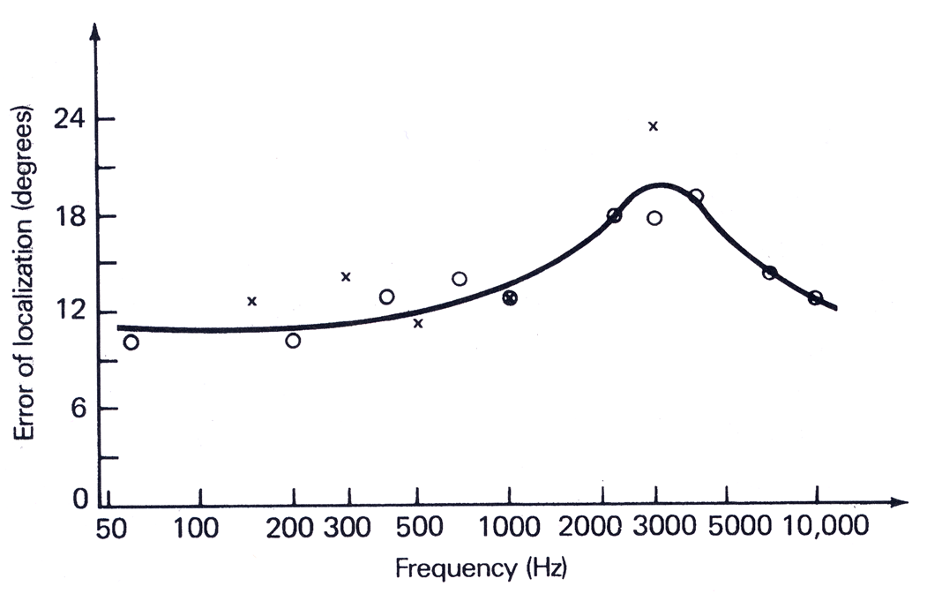
Localization Accuracy vs. Frequency
Signature of a dual-mechanism process?

Slide 51
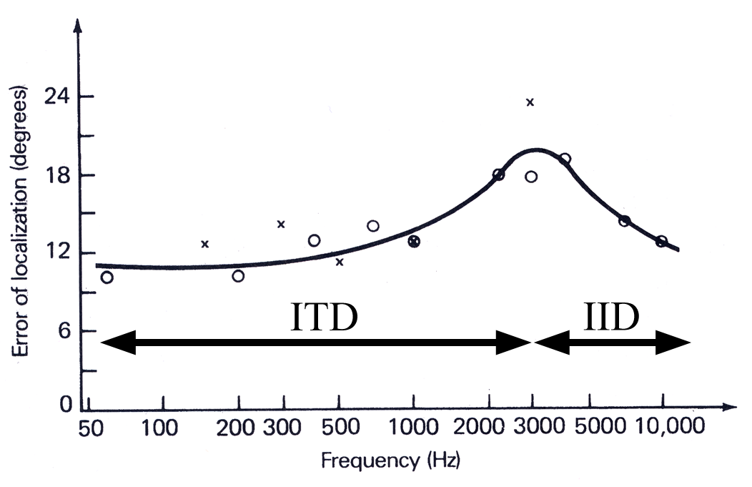
Localization Accuracy vs. Frequency: Low Freq – Interaural Time Difference High Freq – Interaural Intensity Difference
ΔT
ΔI

Slide 52
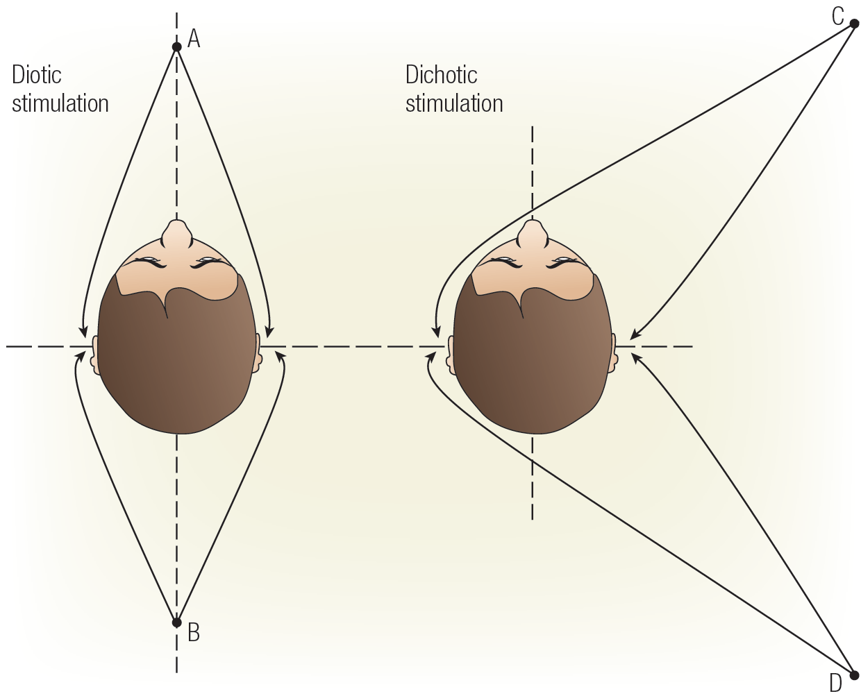
“Diotic” vs. “Dichotic” Stimulation

Slide 53
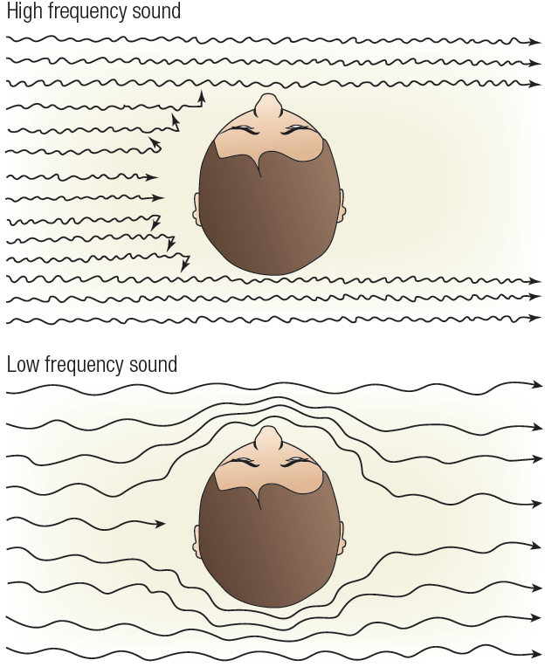
Sound Shadowing (Interaural Intensity Difference –IID)
High-frequency sound waves are “blocked” by the human head and cast a “shadow” at the far ear
(Strong IID cue)
Low-frequency sound waves wrap easily around the head and cast little or no sound shadow (Weak IID Cue)
ΔI

Slide 54
IID = f(Location, Frequency)
ΔI
Straight
Ahead
Straight
Behind
Right Ear
(Perpendicular)

Slide 55
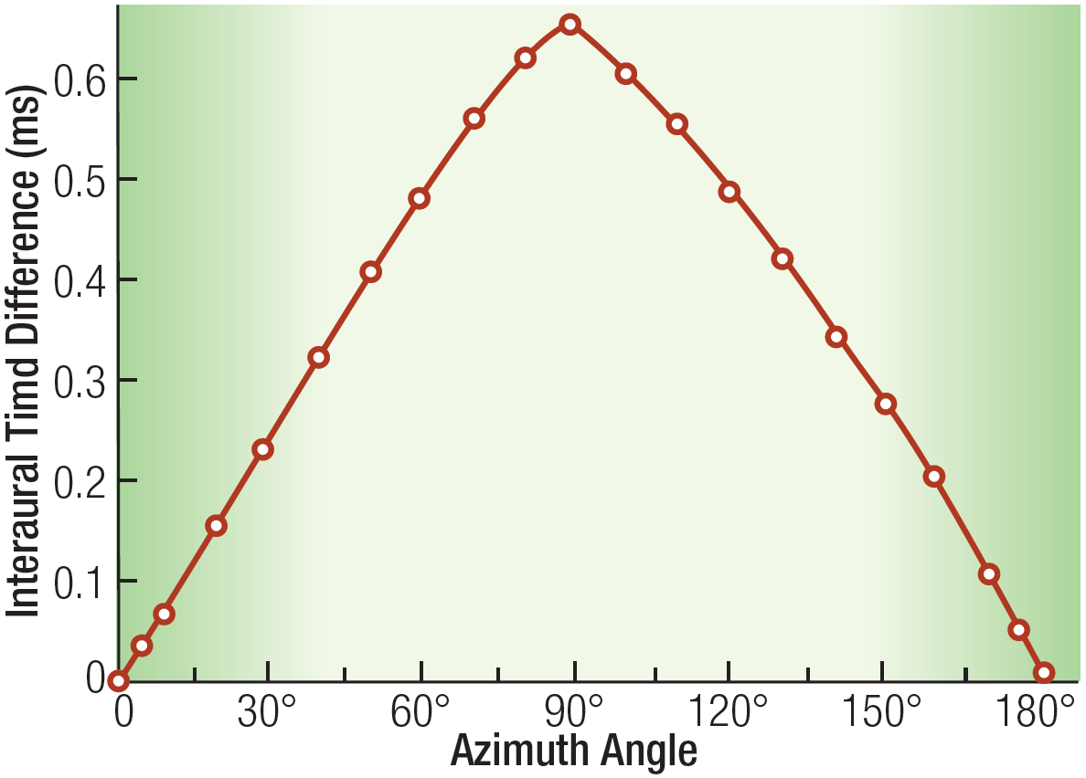
ITD versus Location
ΔT
Straight
Ahead
Straight
Behind
Right Ear
(Perpendicular)

Slide 56
Straight Ahead vs. Straight Behind
Relatively good localization performance despite same IID and ITD levels (i.e., zeros)
Differential sound distortion (“coloration”) introduced by interaction with pinna
Modifying shape of pinna causes immediate reduction in localization accuracy (Hoffman, et al., 1998)
Listening through the ears of another yields “ahead” vs. “behind” confusion (chance performance)

Slide 57
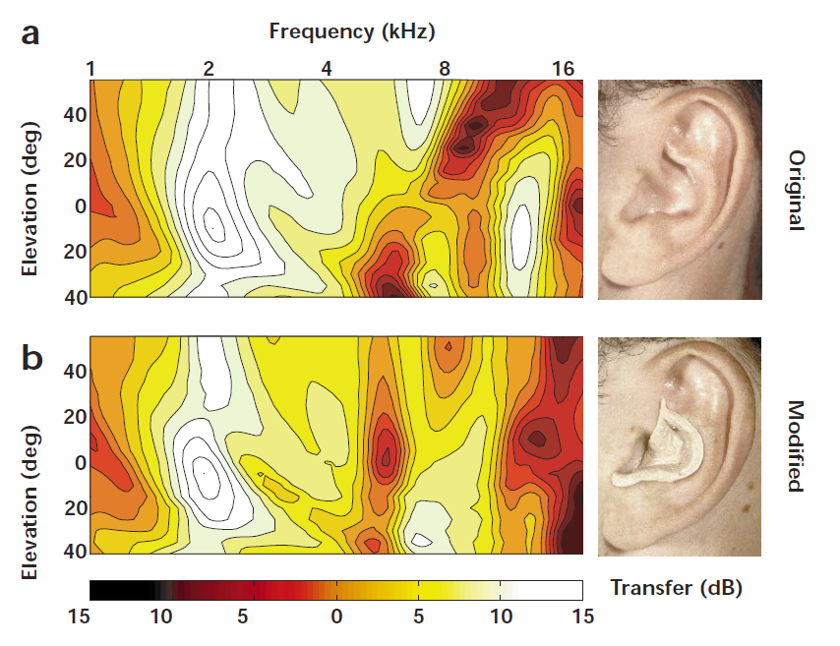
Modifying the Pinna Transfer Function (Hoffman, et al., 1998) Earprints?

Slide 58
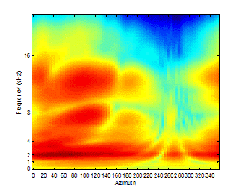
Cross-Section of a Head-Related Transfer Function (Spectral Coloration by Head, Torso & Pinnae)

